Slide 1
Identify and Recognize Person Using Iris Biometric Security System
Supriti Ghosh
Class Roll: 11
Exam Roll: 160011
M.Sc 2nd Semester
Session: 2015-16
Supervisor:
Dr. Mohammad Abu Yousuf
Associate Professor, IIT, JU

Slide 2
Outline
Introduction
Objective
Background
Purpose
Methodology
Feature Extraction
Pattern Matching
Identification and Verification
Simulation Result
Conclusion and Discussion
Reference
Limitation

Slide 3
Introduction
A biometric system provides distinct and automatic identification of an individual based on characteristics.
The iris recognition system consists of the iris acquisition system and iris authentication algorithm.
The performance is measured for stored database which is scored 0% each for FRR and FAR.
Iris recognition is shown to be a precise and reliable biometric technology.

Slide 4
Objective
The main objective is to build a learning framework for biometric security which is capable to:
Normalize iris
Using feature extraction method to produce an exact code
Determine Hamming distance between input images and images in every class.

Slide 5
Background
The concept of iris recognition was first proposed by Dr. Frank Burch in 1939.
It was first implemented in 1990 when Dr. John Daugman created the algorithms for it.
These algorithms employ methods of pattern recognition and some mathematical calculations for iris recognition.

Slide 6
Purpose
ATMs
Computer login: The iris as a living password
National Border Controls
Driving licenses and other personal certificates
Birth certificates, tracking missing
Credit-card authentication
Anti-terrorism (e.g.:— suspect Screening at airports)
Secure financial transaction (e-commerce, banking)
Internet security, control of access to privileged information

Slide 7
Methodology
Image Acquisition
Preprocessing
Feature Extraction
Iris Image
Iris Region
Identify or Reject Subject
Pattern Matching
Identification and Verification

Slide 8
Feature Extraction
The feature of the iris are positioned founded on the polar coordinate structure, Gabor’s multifaceted two-dimensional pass band filters.
The multi-channel Gabor filtering technique is inspired by the psychophysical findings that the processing of pictorial information in the human visual cornet involves a set of parallel.
Wavelet transform is a good scale analysis tool and has been used for texture discrimination.
After applying wavelet transform on an original image, a set of sub images are obtained at different resolution levels.

Slide 9
Pattern Matching
It is very significant to characterize the acquired vector in a binary code as it is easier to treasure the modification between two binary code mechanisms than among two number vectors.
The Hamming distance among input image and images in both class are premeditated.
In the principal classifier, the minimum Hamming distance among input iris code and codes of every class is calculated.
In the subsequent classifier, the harmonic mean of the Hamming distance that have been verified yet is allocated to the class.

Slide 10
Identification and Verification
Identification and verification methods are two main goals of every security system founded on the requirements of the environmental.
It checks if the user data that was entered is accurate or not.
Verification is a one-to-one exploration but identification is a one-to-many assessment.

Slide 11
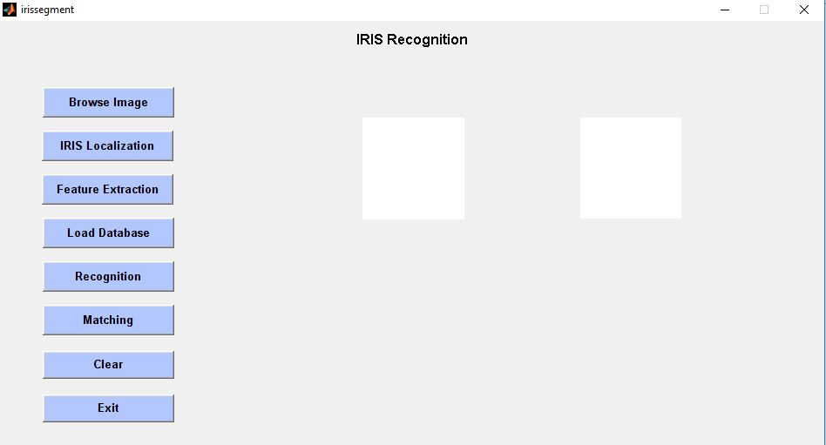
Simulation Result:

Slide 12
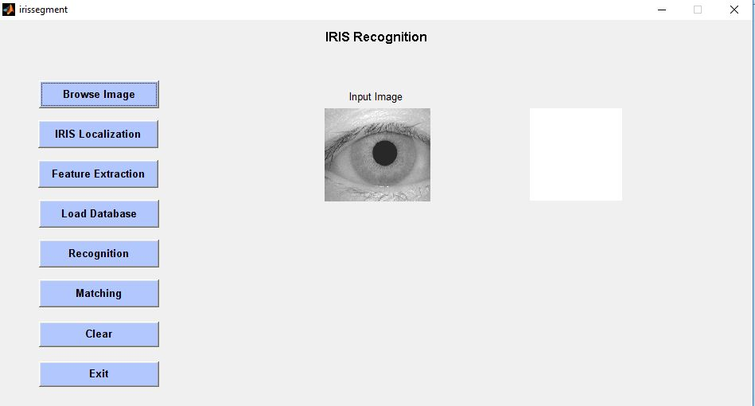
Simulation Result (continue..):

Slide 13
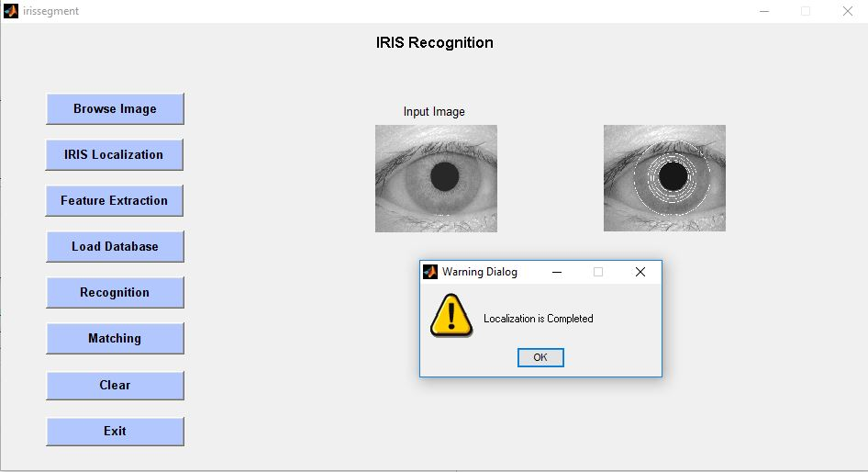
Simulation Result (continue..):

Slide 14
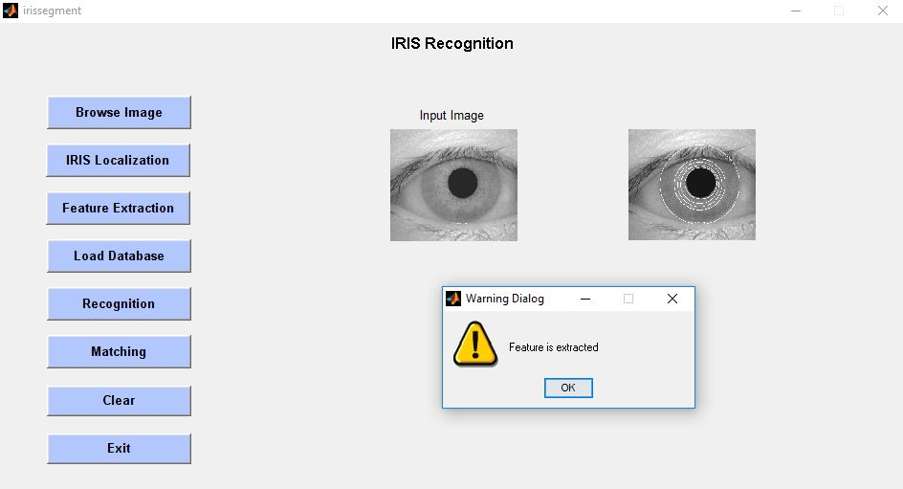
Simulation Result (continue..):

Slide 15
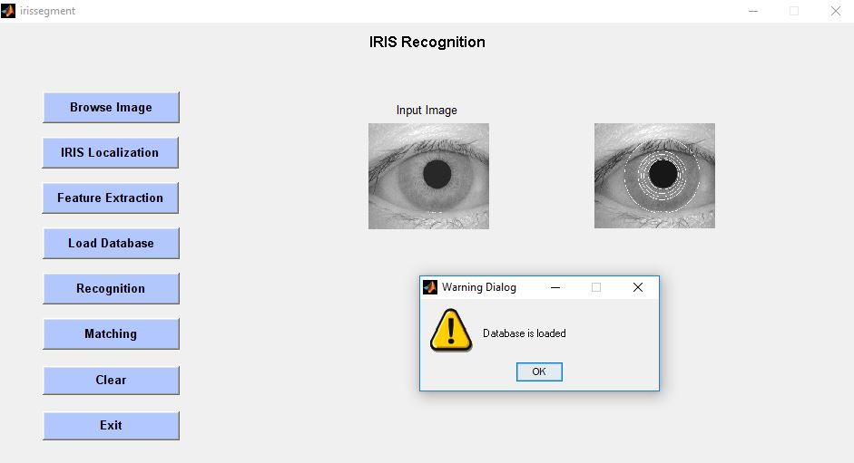
Simulation Result (continue..):

Slide 16
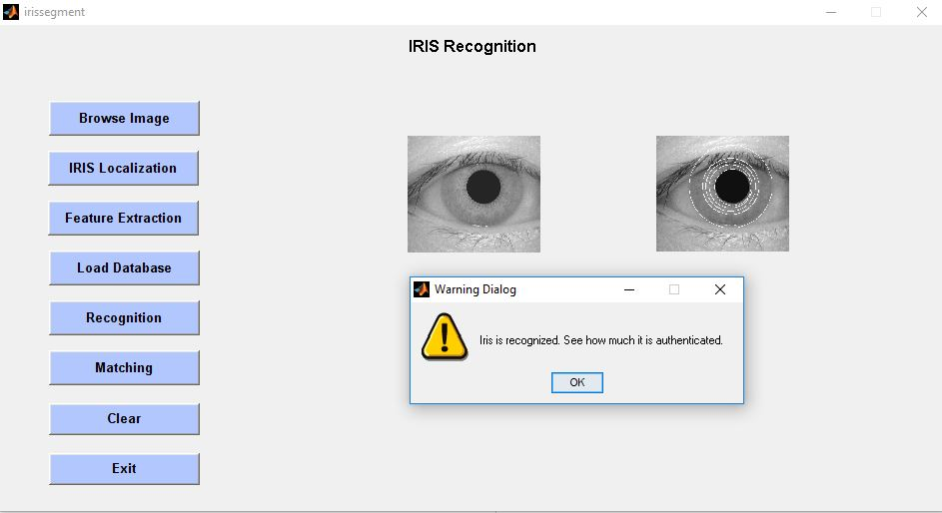
Simulation Result (continue..):

Slide 17
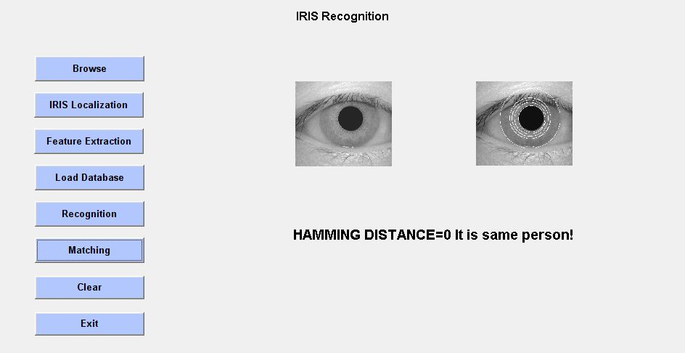
Simulation Result (continue..):

Slide 18
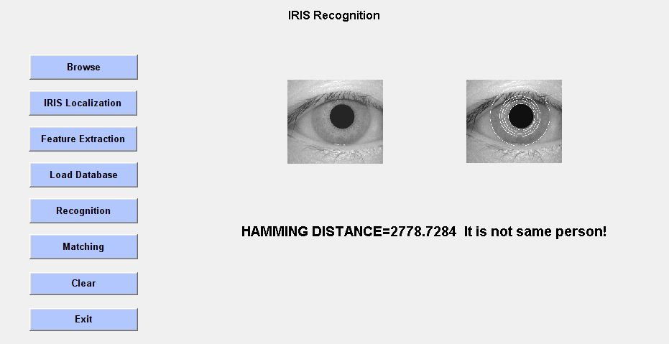
Simulation Result (continue..):

Slide 19
Conclusion and Discussion
The proposed exertion is to enhance the algorithm for efficient person identification for each additional area of applications by cumulative FRR more than 0.33% as the eye procedure consequences with FRR 0.32% and FAR 0.001%.
Wavelets iris recognition procedure is appropriate for dependable, reckless and protected person identification.
.

Slide 20
Conclusion and Discussion (Continue…)
Wavelet, Gabor filter and the assortment of hamming distance for Haar wavelet is a smaller amount i.e., 0.2866 to 0.511111, for robust and fast equivalent for healthcare procedure for persistent identification.
Proposed algorithm focus on rapid and accurate iris identification even if the images are obstruct additional procedure will also concentration on robust iris acknowledgement, even through gazing-away eyes or contracted eyelids which resolves all the safety interrelated difficulties.

Slide 21
Reference
[1] V. Roselin, E.chirchi, Dr. L. M. Waghmare and E. R. Chirchi, “Iris Biometric Recognition for Person Identification in Security Systems”, International Journal of Computer Applications, 0975-8887, Volume 24, No. 9, June 2011.
[2] A. Poursaberi and B. N. Araabi, “A Half-Eye Wavelet Based Method for Iris Recognition”, Procedings of the 2005 5th International Conference on Intelligent Systems Design and Applications (ISDA’ 05) 0-7695-2286-06/05 © 2005 IEEE.
[3] S. P. Narote, A. S. Narote and N. M. Waghmare, “Iris Based Recognition System Using Wavelet Transform”, IJCSNS International Journal of Computer Science and Network Security, Vol. 9, No. 11, November 2009.
[4] C. L. Tisse, L. Torres, M. Robert, “Person Identification Technique using Human Iris Recognition”, Proc. Vision Interface, Pages 2940299, 27 May, 2002.
[5] Y. Zhu, T. Tan, Y. Wang, “Biometric Personal Identification Based on Iris Patterns”, 15th International Conference on Pattern Recognition, 1051-4651, September 2000.
[6] K. B. Jagtap and M. P. Satone, “Biometric Solution for Person Identification Using Iris Recognition System”, International Journal of Engineering and Innovative Technology (IJEIT), 2277-3754, Volume 3, Issue 12, June 2014.
[7] J. M. H. Ali, A. E. Hassanien, “An Iris Recognition System to Enhance E-Security Environment Based on Wavelet Theory”, Advanced Modeling and Optimization (AMO), Volume 5, No. 2, 2003.

Slide 22
Limitations
Accuracy changes with user’s height, illumination , image quality etc.
Person needs to be still, difficult to scan if not co-operated
Risk of fake Iris lenses
Alcohol consumption causes deformation in Iris pattern
Expensive

Slide 23
Thanks to all….

